Slide 1
EDA using Python
Exploratory Data Analysis
~ Pankaj

Slide 2
Supervised ::::::: UnSupervised
Supervised
What I want to predict (Share price, House Price, Buy a loan/not :: Target / Dependent Variable
I will provide data which lead to prediction :: Independent Variable
UnSupervised
I do not have target.
I only have data : Create insight (Segmentation)

Slide 3
Supervised ::::::: UnSupervised
Supervised
What I want to predict (Share price, House Price, Buy a loan/not :: Target / Dependent Variable
I will provide data which lead to prediction :: Independent Variable
Regression : If my Target/Dependent variable is number.
Share price (number), House price (number)
Classification: if my Target/Dependent variable is Binary (0 or 1, True or False) : Yes /No (1 or 0)

Slide 4
Supervised ::::::: UnSupervised
UnSupervised
I do not have target.
I only have data : Create insight (Segmentation)
Clustering Algorithm
We can identify the target/dependent variable

Slide 5

What is EDA?
What is Exploratory Data Analysis in Python?
It is the first step in your data analysis process developed by “John Tukey” in the 1970s.
In statistics, exploratory data analysis is an approach to analyzing data sets to summarize their main characteristics, often with visual methods. By the name itself, we can get to know that it is a step in which we need to explore the data set.
Notes:
Example – If we are

Slide 6

What is EDA?
Why Exploratory Data Analysis is required?
Imagine, going on a Trip.
We will will explore the location on what all places, waterfalls, trekking, beaches, restaurants that location has in Google, Instagram, Facebook, and other social Websites.
Calculate whether it is in your budget or not.
Check for the time to cover all the places.
Type of Travel method.
Notes:
Example – If we are

Slide 7
EDA – Steps required
There are many steps for conducting Exploratory data analysis. I want to discuss regarding the below few steps using the Boston Data Set which can be imported from sklearn.datasets import load_boston
Description of data
Handling missing data
Handling outliers
Understanding relationships and new insights through plots
import pandas as pd
from sklearn.datasets import load_boston
boston = load_boston()
x = boston.data
y = boston.target
columns = boston.feature_names
# creating dataframes
boston_df = pd.DataFrame(boston.data)
boston_df.columns = columns
# overview of the data
boston_df.head()
Notes:
Example – If we are

Slide 8
EDA – Step 1. Describing the data
It helps to understand the different kinds of data and other statistics on our data.
we can apply describe() on a DataFrame (i.e. DataFrame.describe()) which helps in generating descriptive statistics that summarize the central tendency, dispersion, and shape of a dataset’s distribution, excluding NaN values.
The result’s index will include
Count
Mean
Standard Deviation
Min
Max
Lower percentile
50 percentile
Upper percentile
NOTE: The lower percentile is 25 and the upper percentile is 75. The 50 percentile is the same as the median.
Frequently used parameters on Dataframe : dtypes, shape

Slide 9
EDA – Step 2. Handling missing data
Data in the real-world are rarely clean and homogeneous.
Data can either be missing during data extraction or collection due to several reasons.
Missing values need to be handled carefully because they reduce the quality of any of our performance matrix. It can also lead to wrong prediction or classification and can also cause a high bias for any given model being used.
Some techniques to handle the missing values:
Drop NULL or missing values
Fill Missing Values
Predict Missing values with an ML Algorithm
1. Drop NULL or missing values
This is the fastest and easiest step to handle missing values. However, This method reduces the quality of our model as it reduces sample size because it works by deleting all other observations where any of the variables is missing.
boston_df.isnull().sum() # to check null values
boston_df.shape
boston_df = boston_df.dropna()
Drop the column only if there are more than 50% missing values in that column
Notes:
Example – If we are

Slide 10
EDA – Step 2. Handling missing data
2. Fill Missing Values
This is a process whereby missing values are replaced with a test statistic like mean, median or mode of the particular feature the missing value belongs to.
boston_df[‘AGE’] = boston_df[‘AGE’].fillna(30)
3. Predict Missing values with an ML Algorithm
This is by far one of the best and most efficient methods for handling missing data. Depending on the class of data that is missing, one can either use a regression or classification model to predict missing data.
knnImputation(data, k = 10, scale = T, meth = "weighAvg", distData = NULL)
Data : A data frame with the data set
K : The number of nearest neighbours to use (defaults to 10)
Scale : Boolean setting if the data should be scale before finding the nearest neighbours (defaults to T)
Meth : String indicating the method used to calculate the value to fill in each NA. Available values are 'median' or 'weighAvg' (the default).
distData : Optionally you may sepecify here a data frame containing the data set that should be used to find the neighbours. This is usefull when filling in NA values on a test set, where you should use only information from the training set. This defaults to NULL, which means that the neighbours will be searched in data
Notes:
Example – If we are

Slide 11
EDA – Step 2. Handling Outliers
An outlier is something which is separate or different from the crowd.
Outliers can be a result of a mistake during data collection or it can be just an indication of variance in your data. Some of the methods for detecting and handling outliers:
BoxPlot
Scatterplot
Z-score
IQR(Inter-Quartile Range)
Notes:
Example – If we are

Slide 12
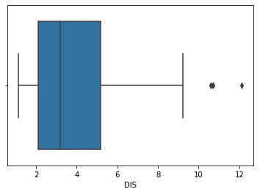
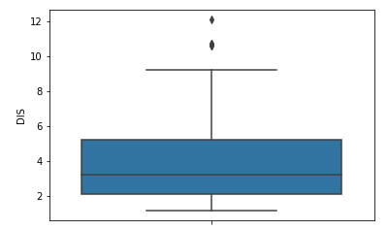
EDA – Step 2. Handling Outliers – Box Plot
A box plot is a method for graphically depicting groups of numerical data through their quartiles. The box extends from the Q1 to Q3 quartile values of the data, with a line at the median (Q2).
The whiskers extend from the edges of the box to show the range of the data. Outlier points are those past the end of the whiskers. Boxplots show robust measures of location and spread as well as providing information about symmetry and outliers.
import seaborn as sns
sns.boxplot(x=boston_df['DIS']) # x-axis or sns.boxplot(y=boston_df['DIS']) 3y-axis
# Single line code for all the numerical variable in dataframe
sns.boxplot(data=boston_df)
or
df.plot(kind='box', title='box plot')
Notes:
Example – If we are

Slide 13
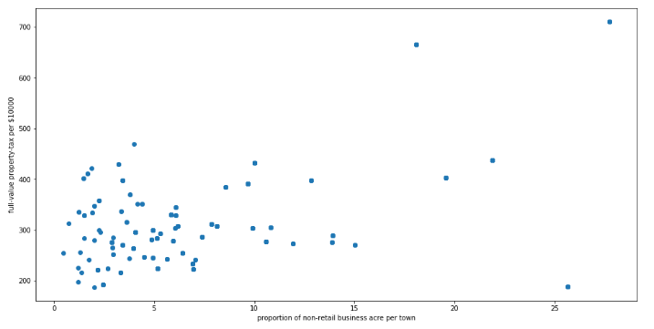
EDA – Step 2. Handling Outliers - Scatterplot
A scatter plot is a mathematical diagram using Cartesian coordinates to display values for two variables for a set of data.
The data are displayed as a collection of points, each having the value of one variable determining the position on the horizontal axis and the value of the other variable determining the position on the vertical axis.
The points that are far from the population can be termed as an outlier.
import matplotlib.pyplot as plt
fig, ax = plt.subplots(figsize=(16,8))
ax.scatter(boston_df['INDUS'] , boston_df['TAX'])
ax.set_xlabel('proportion of non-retail business acre per town')
ax.set_ylabel('full-value property-tax per $10000')
plt.show()
Notes:
Example – If we are

Slide 14
EDA – Step 2. Handling Outliers – Z-score
The Z-score is the signed number of standard deviations by which the value of an observation or data point is above the mean value of what is being observed or measured.
While calculating the Z-score we re-scale and center the data and look for data points that are too far from zero.
These data points which are way too far from zero will be treated as the outliers.
In most of the cases a threshold of 3 or -3 is used i.e. if the Z-score value is greater than or less than 3 or -3 respectively, that data point will be identified as outliers.
from scipy import stats
import numpy as np
Z = np.abs(stats.zscore(boston_df))
boston_df_outlier = boston_df[ (Z > 3).all(axis = 1) ]
Notes:
Example – If we are

Slide 15
EDA – Step 2. Handling Outliers - IQR
The interquartile range (IQR) is a measure of statistical dispersion, being equal to the difference between 75th and 25th percentiles, or between upper and lower quartiles.
Q1 = boston_df.quantile(0.25)
Q3 = boston_df.quantile(0.75)
IQR = Q3 – Q1
Once we have IQR scores below code will remove all the outliers in our dataset.
boston_df[~( (boston_df < (Q1 – 1.5 * IQR) ) | (boston_df > (Q3 – 1.5 * IQR) ) ).any(axis = 1)]
To Handle outlier – we treat them like Missing number
Notes:
Example – If we are

Slide 16
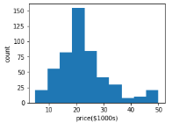
EDA - Understanding relationships and new insights through plots
We can get many relations in our data by visualizing our dataset. Let’s go through some techniques in order to see the insights.
Histogram
HeatMaps
Histogram:
A histogram is a great tool for quickly assessing a probability distribution that is easy for interpretation by almost any audience. Python offers a handful of different options for building and plotting histograms.
plt.figure(figsize = (4,3))
plt.hist(boston.target)
plt.xlabel(‘price($1000)’)
plt.ylabel(‘count’)
plt.tight_layout
Notes:
Example – If we are

Slide 17
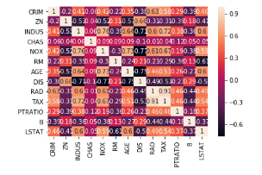
EDA - Understanding relationships and new insights through plots
HeatMaps:
The Heat Map procedure shows the distribution of a quantitative variable over all combinations of 2 categorical factors. If one of the 2 factors represents time, then the evolution of the variable can be easily viewed using the map.
A gradient color scale is used to represent the values of the quantitative variable. The correlation between two random variables is a number that runs from -1 through 0 to +1 and indicates a strong inverse relationship, no relationship, and a strong direct relationship, respectively.
correlation_matrix = boston_df.corr().round(2)
sns.heatmap(data = correlation_matrix, annot = True)
Notes:
Example – If we are

Slide 18
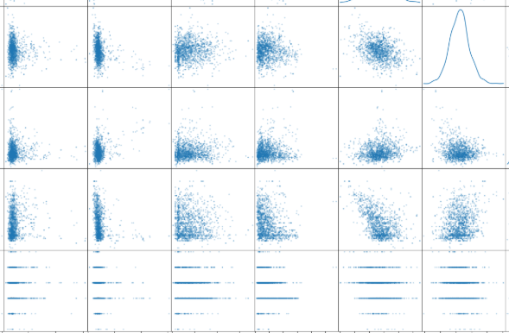
EDA - Understanding relationships and new insights through plots
Pairs Plot:
This is a extension to scatter plots and histogram and its PDF representation. This is primarily used when we want to study the behavior of all variables with every other variables when the data is more than 2-Dimension.
pandas.plotting.scatter_matrix(boston_df, alpha = 0.3, figsize = (40,40), diagonal = 'kde‘)
sns.pairplot(boston_df)
sns.pairplot(boston_df, hue = ‘name_of_categorical_column’)
Notes:
Example – If we are

